Slide 1
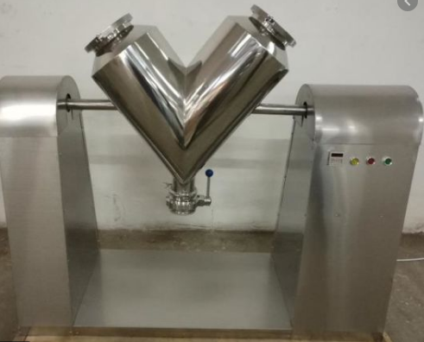
V BLENDER
Mfg.& Exp. Of Plants & Machineries for Pharmaceuticals,
Cosmetics, Chemicals food & Beverage Industries
Plot No. 1601/1,3rd Phase G.I.D.C., Vapi-396195. (Gujarat)
Email:sales@sidhipharmaequiment.com:sidhipharmaequipments@gmail.com:
Contact Person : Mr. Pravin Panchal (9924893790) Mr. Kiran Gophane (9545868896)
Website: www.sidhipharmaequipment.com

Slide 2
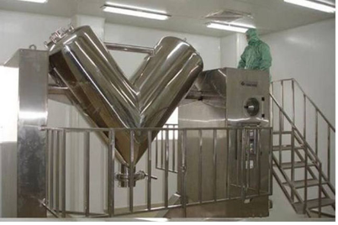
V Blender :
V Blender equipment is very useful in the pharmaceutical and food manufacturing industries. It is also referred to as the twin shell blender and is widely used in industry. This is because it offers a short blending time and highly efficient in operation.
The machine is made up to 2 hollow cylindrical containers joined together at an angle of 75 to 90 0. As the V blender tumbles the material is continuously separated and recombined, and thorough mixing occurs as it falls randomly in the vessel. The repeated converging and diverging motion enhances the frictional contact between the material and the vessel giving a gentle and homogenous blend.

Slide 3
Silent Features :
In “V” Blender the powders comes from all sides due to the “V” shape of the product container, hence requirement of RPM is medium. Suitable mainly for powder & granules type material.
The “V” shape gives sufficient continuous movement to the granules, result in good quality.
Maximum care has been taken to ensure safe operation of the unit.
Manual rotating facility with hand wheel for inching
Particle size reduction is minimized due to the absence of any moving blades. The shape of blender body results in a near complete discharge of product material, clearly an added advantage over horizontal blender
The V blender is good for blending dry powders and granulated products
Internal attachments like lump breakers and liquid dispensers widen the applications of this blende
Advantageous\ Benefits :
Wet and dry mixing
High shearing force
Serial dilution is not needed
Easy handling.
Minimum maintenance

Slide 4
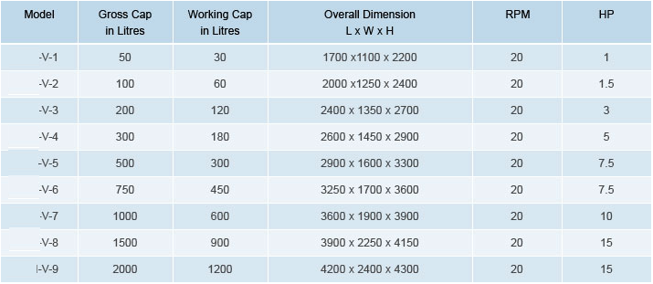
Technical Specification :
Single Source Provider for all your technical requirements.
One of the most important “Siddhi Pharma Equipment” guideline is to be closest to our Customers. We strive to create end-to-end solutions that meet our clients needs and their expectation.
Application :
Pharmaceutical
Food
Chemical
Cosmetics
Allied Industry

